Slide 1
Schizophrenia: Diagnosis and Treatment
By Stacey Lambour, BSN, RN

Slide 2
What is Schizophrenia
Schizophrenia is a complex brain disorder, typically occurring in the early adulthood.
Marked by devastating changes in personality and cognition
After 1st episode, Schizophrenia is life long
Notes:
Schizophrenia is a complex psychiatric disorder. Characterized by severe changes in the patients behavior and thinking. Typical onset begins in late adolescence or early adulthood and once the patient has had their first episode the disease is life long.

Slide 3
Schizophrenia Statistics
Worldwide prevalence is 1%.
Age of onset
Men 15-25 years old
Women 25-35 years old
High risk for suicide, 10% are successful.
Reduced life expectancy of 15-25 years
BILLIONS spent annually on direct and indirect care.
(CDC, 2011)
Notes:
The worldwide prevalence of schizophrenia is approximately 1%. Historically most studies state that it occurs equally in men and women, however a few newer studies suggest that it occurs slightly more often in men than it does in women, with 1.4 men being diagnosed for every 1 women.
The age of first onset is typically younger in men, usually about 15-25 years of age for men and 25-35 years of age for women. By age 30, 9 out of 10 men, and only 2 out of 10 women, will have manifested the disease. However patients can be diagnosed with schizophrenia at any age.
People with schizophrenia pose a high risk for suicide. Approximately one-third will attempt suicide and about 10% will successfully commit suicide.
CDC 2011
Patients with schizophrenia have a decreased life expectancy of 15-25 years, this is partially related to their high risk behaviors and suicide but also from complications from medical disease such as diabetes, cardiovascular disease and other associated metabolic syndromes. The medications that are used to treat schizophrenia, and lifestyle choices put the patients at risk for many medical issues, and they do not often receive the proper follow up and treatment for these disorders.
The world health organization consistently ranks schizophrenia as having one of the highest levels of global burden.
In the U.S. in 2002 the cost of schizophrenia was estimated to be $62.7 billion dollars,
$22.7 billion in direct health care cost
$7.0 billion outpatient,
$5.0 billion drugs,
$2.8 billion inpatient,
$8.0 billion long-term care
The study estimated that $7.6 billion was spent in additional law enforcement and in homeless shelters and $32.4 billion was lost from unemployment, reduced productivity, premature mortality, and additional caregiving expense.
Wu, et al 2002

Slide 4
Historical Background
Psychosis has been around as long as there has been recorded history
Late 1800s’ Emil Kreapelin differentiated mental illnesses- “Dementia Praecox” was what is now called schizophrenia
Early 1900s’ Eugene Bleuler coined the term “Schizophrenia”
1950s’Kurt Schneider defined “First Rank Symptoms”
(Sadock, 2007)
Notes:
There is evidence of psychosis in Egyptian, Greek and Roman text. It is hard to identify what type of mental illness people were suffering from because all illness were grouped together illnesses in those days. However, the prevalence of Schizophrenia has remained fairly stable since we have begun to track it, so I think it is safe to assume that some of the documented cases of psychosis in early history were related to schizophrenia.
Even though Schizophrenia has always impacted societies, it wasn’t until the early 1900s’ that it was more clearly defined.
In the Late 1800s’, Emil Kreapelin, a German physician, differentiated several mental illnesses, in particular he identified dementia praecox, He distinguished this illness from manic depressive disorder by identifying that these patients had an early onset, that there was a change in cognition, and that they would continue to deteriorate over time, as apposed to intermittently stabilizing as seen in bipolar disorder. He also noticed that they would suffered from hallucinations and delusions.
In the Early 1900s’ Eugene Bleuler, a Swiss psychiatrist, coined the term “schizophrenia,” Like Kreaplin, Bleuler, felt that hallucination and delusions were characteristic of this disease, but unlike Kreaplin, Bleuler did not feel that schizophrenia always had a deteriorating course of illness. He used the term “schizophrenia” to describe the division between thought, emotion and behavior that is frequently seen in schizophrenia. He is also responsible for coming up with the four A’s of schizophrenia: association, affect, autism and ambivalence. The four A’s identify areas of deficits that are associated with schizophrenia and are still used as part of the definition today.
In the 1950s’ Kurt Schneider introduced first rank symptoms, while not specific to schizophrenia, Schneider believed that patient with schizophrenia often presented with these type of hallucinations or delusions.
Saddock 2007

Slide 5
First Rank Symptoms
Audible thought
Voice Arguing
Voice Commenting
Somatic Passivity
Thought withdrawal or insertion
Thought Broadcasting
Delusional Perceptions
“Made” affect or impulse
(Sadock, 2007)
Notes:
Audible thoughts may be described by the patient as their thought echoing
Voice arguing is when the patient can discern two or more voices, often the are arguing and it is often about the patient.
Voice Commenting is when the patient hears a running commentary about his actions and thoughts, usually with a negative tone.
Somatic passivity is the belief by the patient, that he or she is being made to feel a sensation by someone or thing other than him or her self.
Thought withdrawal or insertion is when the patient believes his or her thoughts being inserted or removed from their mind by someone or something.
Thought Broadcasting is when the patient believes his or her thought are being broadcasted to others
Delusional perception are also called Bizarre delusions, bizarre delusions are different from non bizarre delusion in that bizarre delusions have no basis in reality, for example a patient feels that someone took all his organs, but there is no evidence of surgery and the patient is still alive.
Made affect or impulse is the belief that the patient is being controlled by someone or something and the feelings they feel, the movements they make, the words they speak they don’t believe they are controlling any of it.

Slide 6
Causes of Schizophrenia???
Genetics & Environment
Genetics
12% prevalence that a schizophrenic parent will have a schizophrenic child
50% concordance rate in monozygotic twins
15% concordance rate for dizygotic twins
Age of father
Antenatal and postpartum complications
Immigration
Notes:
So what cause Schizophrenia, well we don’t actually know but we do know that genetics play a significant role.
In the general population, without any family history, there is a 1% chance that anyone could develop schizophrenia. If you have a parent with schizophrenia, the risk for manifesting the disease jumps to 12%, When twin studies were done, they found that the concordance rate among monozygotic twins was 50%, whereas dizygotic twins had only a 15% concordance rate. This illustrates that while there is a strong genetic component, there are other factors that must interact for the disease to manifest.
There is a great deal of research in the area of schizophrenia and possible risk factors, paternal age, maternal stress and immigration all appear to have a positive correlation with an increase risk in schizophrenia.
Several studies have shown advanced paternal age at the time of conception, presents an increased risk that the offspring will have schizophrenia, despite having no family history. The belief is that there may be a malfunction during spermatogenesis that leaves the offspring more vulnerable to schizophrenia.
Many studies show that mothers who were under extreme stress during pregnancy , especially in the 1st trimester, had an increased incident of having a child who later developed schizophrenia. It is well document that there were higher than average rates of schizophrenia in people that were conceived during a famine. There is also some evidence that women who were exposed to influenza in their first trimester had schizophrenic children at higher rates than those who were not exposed to influenza. The hypothesis in all these studies, relates to maternal stressors interfering with neurodevelopment in the early stages of pregnancy, thus putting the child at increased risk for schizophrenia later in life. More research still needs to be done, but it is a reasonable hypothesis.
There are also several different studies that correlate delivery complications such as preterm labor, fetal hypoxia, and hemorrhage with an increase the risk for schizophrenia. Although the evidence isn’t overwhelming and more research needs to be done, the belief is that early trauma to the brain increases the risk for schizophrenia.
Immigration has also been associated with a risk for schizophrenia. There is a great deal of evidence linking 1st and 2nd generation immigrants to above average rates of schizophrenia when compared to the general population. This is especially true when the immigrants are moving to an area where their culture is perceived negatively. It is not fully understood if mental illness may have precipitated the move to another area or if the stress of moving to a hostile nation hastened the development of schizophrenia. Either way schizophrenia and immigration appear to have a connection.

Slide 7
Causes of Schizophrenia???
Abnormalities in Brain structure, Circuitry, and Chemical Messengers
Impaired Neurodevelopment
Enlarged Cerebral Ventricles
Decreased size in Frontal lobe
Excessive Pruning
Hyperactive Dopamine
Hypoactive Glutamate
Inflammatory Disease
Autoimmune Disorder
Notes:
So while are beginning to understand what may increase the risk of schizophrenia, we are also trying to find out what exactly is happening in the brain of these patients with so that we can develop better treatments and maybe one day find a cure.
It is still unclear whether it is a neurodevelopment disease or a neurodegenerative disease because it has signs of both. As I said in the last slide, there is some evidence that impaired neurodevelopment in utero may put someone at risk for schizophrenia, and there is evidence that enlarged cerebral ventricles have been observed in fetuses of schizophrenic patients. It has also been observed in fMRI studies and postmortem studies that many patients with schizophrenia have enlarged cerebral ventricles. However, enlarged cerebral ventricles have been seen in other mental health disorders, and having enlarged cerebral ventricle alone does not put a person at increased risk for development of any mental health disorder.
Other changes that are often associated with schizophrenia are a decrease in frontal lobe tissue, many deficits in organization which are characteristic of schizophrenia, can be associated with a frontal lobe impairments. One theory that explains the timing of the illness onset and the decrease in frontal lobe mass is that excessive pruning during adolescents lead to the development schizophrenia.
There is overwhelming evidence that suggests that the dysfunction of specific neural pathways can account for the positive, negative and cognitive deficits seen in schizophrenia, but research still has not found out why the dysfunction happens and how do we prevent it from happing.
One of the first substantial theory that provided an explanation of the disease dysfunction and also offered an explanation about why the treatment worked, was the dopamine hypothesis of schizophrenia. This states that an excess of dopamine is responsible for the changes seen in the patient with this disease. While this theory provided a good foundation for understanding schizophrenia it was not specific about why there was an increase in dopamine activity. The theory also focused on the positive symptoms of schizophrenia and not the negative. So as time went on it became clear that dopamine was not the only neurotransmitter involved in the disease. Excessive serotonin is believed to play a role in the schizophrenia and the current atypicals’ tend to have an antagonist effect on serotonin.
As well, there is evidence that GABA, which inhibits the activity of dopamine, plays a role too. Some studies show that patients with this disease have a loss in GABAanergic neurons in the hippocampus. Malfunctions in GABA would lead to increase dopamine. It has also been hypothesized that Glutamate, which excites GABA, could be the source of the problem. Glutamate became a neurotransmitter of interest when people recognized that when glutamate antagonist is taken, healthy patients can create a schizophrenia like syndrome. The theory is that Hypoactive glutamate, results in decreased excitement of GABA which lead to decreased inhibition of dopamine, which then leaves an excess of dopamine. It is difficult to test this theory because of the sensitivity of Glutamate. While all the theory sounds logical, there just isn’t enough evidence to prove any one theory, and most don’t account for all the problems that exist with schizophrenia. We are beginning to understand what is happening in the brain but more research needs to be done in this area. Current research is working to understand why and how the neurotransmitters and pathways are disrupted in schizophrenia.
Some new and interesting research looks at schizophrenia as a inflammatory or autoimmune response. The theories suggest that environmental and genetic factors cause an inflammatory /autoimmune response which begins in neurodevelopment and overtime change the biochemistry in the brain accounting for the varied behaviors related to schizophrenia, as well as, the late onset. The belief is that inflammation in the Central Nervous System causes the dysfunction in the neurocircuitry. There is some evidence that patient with schizophrenia have higher levels of cytokines, which can be associated with an inflammatory or autoimmune response, but it can also be associated with other causes. There is not much research in this area, but I think it warrants further investigation, because it is starting to look for a cause and not just treating the symptoms.

Slide 8
DSM IV-TR Criteria
A. Characteristic symptoms: Two (or more) of the following, each present for a significant portion of time during a 1-month period (or less if successfully treated):
(1) delusions
(2) hallucinations
(3) disorganized speech (e.g., frequent derailment or incoherence)
(4) grossly disorganized or catatonic behavior
(5) negative symptoms, i.e., affective flattening, alogia, or avolition
Note: Only one Criterion A symptom is required if delusions are bizarre or hallucinations consist of a voice keeping up a running commentary on the person's behavior or thoughts, or two or more voices conversing with each other.
(DSM IV TR, 2000)
Notes:
Now let’s look at how we would diagnosis a patient with Schizophrenia. It is not very easy the patient must fulfill six criteria before they can be diagnosed.
For Criteria A the patient must present with at least two of the five symptoms, each having a duration longer than 1 month, or less if successfully treated.
1. Delusions Delusions are a strongly held inaccurate belief even when evidence is presented to the contrary. There are several categories of delusions. Some of the more common themes are persecutory and referential delusions. persecutory delusions the person thinks that someone or something is going to or wants to cause them harm. Referential delusions are when the person erroneously attaches excessive meaning to seemingly insignificant interactions believing that they are specifically directed towards him or her.
2. Hallucinations
Hallucination can originate in any of the five senses. Auditory are the most common. Patients may say they have echoing in there head, or that one or more voice may be arguing,
3. Disorganized speech
The patient may be utterly incoherent, producing words that make no sense together, that would be an example of word salad. Example dog fish bob was lunch.
Or the may take a long time to answer your question filling the answer in with an excessive amount of irrelevant detail that is know as circumstantiality.
They may not answer the question at all jumping from subject to subject with very loose associations between topics, and that would be considered tangentially,.
4. grossly disorganized or catatonic behavior, the patient may present with an unkempt appearance, shuffling through papers, or have difficulty completing task, not dressed appropriately for the season. This creates a great deal of difficulty with performing everyday functions.
5. negative symptoms, affective flattening, or avolition. It may appear as thought the patient has little interest in doing anything, similar to a presentation of a depressed person, except that there is a complete lack of emotional involvement in a schizophrenia patient. .
There is an exception that if a patient is displaying any of the first rank symptoms in the hallucinations or delusions they only have to meet one of criteria a and not two.

Slide 9
DSM IV-TR Criteria
B. Social/occupational dysfunction:
C. Duration: Continuous signs of the disturbance persist for at least 6 months.
D. Schizoaffective and Mood Disorder exclusion:
E. Substance/general medical condition exclusion
F. Relationship to a Pervasive Developmental Disorder
(DSM IV TR, 2000)
Notes:
In additional to Criterion A the patient must fulfill these other categories
B. Social/occupational dysfunction: For a significant period of time since the illness started the patient must have difficulty functioning at work, in relationships, maintaining self care. This difficulty must represent a change in functioning , or for a child they are not were they are expected to be.
C. Duration: The symptoms must have lasted for 6 months, with an active period of 1 month, or less if successfully treated. During the 6 months the patient can exhibit disturbance but in a lesser from than during the active phase.
D. Schizoaffective and Mood Disorder exclusion: Schizoaffective Disorder and Mood Disorder With Psychotic Features must be ruled out. Major Depressive, Manic, or Mixed Episodes have not occurred along the active phase symptoms; but if mood episodes were present during the active-phase symptoms, the duration was brief.
E. Substance/general medical condition exclusion: Other medical conditions have been ruled out.
F. Relationship to a Pervasive Developmental Disorder: If the patient has Autistic Disorder or another Pervasive Developmental Disorder, a Schizophrenia diagnosis can only be made delusions or hallucinations are also present for at least a month (or less if successfully treated).

Slide 10
DSM IV-TR Sub types
295.20 Catatonic Type
295.10 Disorganized Type
295.30 Paranoid Type
295.90 Undifferentiated Type
295.60 Residual Type
(DSM IV TR, 2000)
Notes:
Schizophrenia also has subtypes they are used to classify the predominant symptoms that the patient is currently displaying,
295.20 Catatonic Type
This type is rare it is characterized by a profound chance in motor activity. These patient can remain motionless for extended periods of time. They have a tendency to stop speaking. They may exhibit echopraxia, which is the involuntarily repetition of observed movement. If there are any signs of catatonia the patient will be classified as catatonic type.
295.10 Disorganized Type
If The patient has symptoms of disorganized speech, or behavior, inappropriate affect and does not meet the criteria for Catatonic type they would received the disorganized diagnosis.
295.30 Paranoid Type
This patient would have a preoccupation with delusions or hallucinations and not meet any of the above criteria.
295.90 Undifferentiated Type
The patient doesn’t meet any of the criteria for the above mention subtypes, they they are labeled as undifferentiated type
295.60 Residual Type
The patient would have an absence of prominent delusions, hallucinations, disorganized speech, and grossly disorganized or catatonic behavior but there would be evidence of continued disturbance.

Slide 11
DSM IV-TR Classification of Course
Episodic With Interepisode Residual Symptoms.
With Prominent Negative Symptoms
Episodic With No Interepisode Residual Symptoms.
Continuous.
With Prominent Negative Symptoms
Single Episode In Partial Remission.
With Prominent Negative Symptoms
Single Episode In Full Remission.
Other or Unspecified Pattern.
(DSM IV TR, 2000)
Notes:
There are also classifications related to the course of schizophrenia, I am not going to go over them, they are fairly self explanatory.

Slide 12
DSM V Proposed Changes
Criterion A
delusion
hallucinations
disorganized speech
grossly abnormal psychomotor behavior, including catatonia
negative symptoms, e.g., restricted affect or avolition/asociality
Must meet two of the symptoms in criterion A, and 1 must be hallucinations, delusions or disorganized speech
Criterion F
Addition of communication disorder
Deletion of subtypes
(APA, 2012)
Notes:
The DSM 5 is proposing that this be the new criteria for Schizophrenia.
For Criterion A they have clarified some of the characteristic symptoms, they would like to require one of the two symptoms to be hallucinations, delusions or disorganization, as well they also would like to do away with the exclusionary criteria for Criterion A. The evidence just doesn’t show that the first rank symptoms are reliable to diagnosis schizophrenia.
For Criterion F, related to Autism and Pervasive Developmental Disorder, they would like to add or other communication disorder of childhood onset. They have found that other communication disorders do cause negative symptoms and disorganized speech.
And they would like to delete all subtypes, they found that it wasn’t useful in determining the course of illness.

Slide 13
Prognosis Indicators
Improved Outcomes
Poor Outcomes
Late Onset
Acute Onset
Married
Good Support System
Positive Symptoms
Abnormal symptoms that start with schizophrenia
Early Onset
Gradual Onset
Single
Poor Support System
Negative Symptoms
Normal behaviors that decline with schizophrenia
(Sadock, 2007)

Slide 14
Treatment Methods
Medications Management
Therapeutic Interventions
Community Interventions
Notes:
Antipsychotic medications are the first line drug of choice used to treat schizophrenia.
Psychosocial approached are meant to enhance treatment but they are not a substitute for medication treatment, and psychosocial techniques are most helpful after drug treatment has been initiated
To effectively care for patients with mental illness and specifically schizophrenia, it is important not to overlook the role that the community plays
If we are going to make an impact on the effect of schizophrenia we are going to have to all work together.

Slide 15
Medication Management
Treat Schizophrenia
Treat Side Effects
Treat Co-occurring Mental Health Disorders
Treat Medical Condition
Notes:
Assuming we have a perfectly healthy patient, The goal is to treat the symptoms of schizophrenia 1st and the side effects if they have them, or concurrently if the medications will likely cause them, then treat the other mental health disorders. Hopefully you will not have to treat the medical conditions immediately. If your patient already has an array of medical problem you will want to tailor your treatment around the medical existing medical issues. For example you have a patient with a heart condition, choose the antipsychotic least likely to effect the heart.

Slide 16
Antipsychotic Treatment
Antipsychotic medication
Side Effects
Extrapyramidal symptoms - akathisia, parkinsonism, dystonia
Tardive Dyskinesia
Neuroleptic Malignant Syndrome
QT wave prolongation
(Up to Date, 2012)
Notes:
Antipsychotic medications have a great deal of side effects, it is important to be conservative when you treat a patient with them. There are two broad categories of antipsychotic medications First generation or typical antipsychotics and second generation antipsychotic or atypical. Typical antipsychotics bind predominately to dopamine, treat positive symptoms very well and are generally associated with more extrapyramidal symptoms. Atypical’s interact with several dopamine receptor, as well as serotonin, they work better for negative symptoms and are generally associated with fewer extrapyramidal symptoms.
Let’s go over some of the more severe side effects.
Akathisia is motor restlessness, a patient may complain about this even without visible signs. If so you should evaluate is the have difficulty sitting still. For treatment of this symptom you can try to lower the dose, you could try benzodiazapam, making sure you keep them on the lowest dose possible because their own side effects, or you could try a beta blocker.
Parkinsonism- the patient may present with shuffling gat, resting tremors, or psychomotor slowing. This can be treated with the anticholinergic agent Cogentin, however if that is not tolerated the patient can try amantadine
Dystonia is acute involuntary muscle contractions- highly disturbing to patients- I can attest that this is extremely scary, this happens to me with Compazine, this can be treated with Cogentin or diphenhydramine, either IV or IM. For patients that have a mild form they can take po Cogentin. Make sure that patient is observed by someone when starring a medication.
Tardive Dyskinesia- involuntary muscle movement after long term antipsychotic medication use. Symptoms may include lip smacking, facial grimacing, jaw movement, movement in the extremities. Patients should be evaluated at each visit for development of tardive dyskinesia. Tardive dyskinesia can become permanent. If TD begin, the antipsychotic should be weaned down and stopped, the patient should be switched to another drug Cloziril and Seroquel have very low risk of TD. If discontinuing the drug is not feasible, the patient can be put on benzodiazapam, or Cogentin, for severe debilitating TD patients can be given BoTox.
NMS is rare but life threatening, it will typically happen in the first few days of treatment generally the patient will present with a change in mental status, which can be underappreciated in the mental health population, which then progresses to extreme muscle rigidity, fever, tachycardia, tachypnea, diaphoresis, and hypertension. The patient needs immediate medical attention and the drug should be discontinued IMMEDIATELY!!!!
QT prolongation- many of the antipsychotics have this side effect, if you have a patient with heart disease choose a antipsychotic that is less likely to cause prolongation like Abilify or Latuda. Also get an ECG prior to medication initiation.

Slide 17
Antipsychotic Medication
Side Effects Continued….
Prolactinemia
Metabolic Side effects
Seizure
Orthostatic Hypotension
Anticholinergic effects
Sedation
Death
Agranulocytosis
(Up to Date, 2012)
Notes:
For the side effects you want to be mindful of these while starting on managing treatment.
First generation antipsychotics, risperdal and invega have a tendency to cause this more than other, if your patient is experiencing galactorrhea, sexual dysfunction or gynomastia, you should evaluate their prolactin level. If high you can change to alternate a medication or give medication to bring down the prolactin level.
The medication can cause weight gain, hyperlipidemia, hyperglycemia, and hypertension, you should always get a baseline labs prior to staring medication that way you will be able to evaluate the effects of the medication on the patient. You can encourage proper diet and exercise, and manage medical disorders as they come up or refer to a primary care clinician. Abilify and Geodon are less likely to cause weight gain so if you have a client that is already suffering from these condition you may want to start with one of them.
Most antipsychotics lower the seizure threshold for seizures, so if you have a patient with an existing seizure disorder work closely with the patient neurologist because the anticonvulsant may need to be increased.
Orthostatic hypertension generally occurs the first few days of treatment, so it is important to advise you patient to switch position slowly and gradually increase dosing.
Anticholinergic effects such as dry mouth, constipation, visual disturbances, and cognitive impairment are often seen they, tends to be worse with older adults.
Sedation is a common effect, after a few weeks of treatment it will get better but patients may want to take the medication at night at least in the beginning of treatment.
For some reason patients starting antipsychotics have an increased risk of sudden death, it is estimated that about every 2 out of 1000 patients started on antipsychotics could experience sudden death. the exact mechanism is not understood although some believe it may be related to the QT prolongation in the heart.
Agranulocytosis is specific to clozapine, Cloziril, so it important to monitor WBC counts for patient taking Cloziril. If this is not caught early it could become permanent. Most case will start within the first four months of treatment, initially regular blood test should be done.
It is no surprise that with all the side effects and follow up needed for medication management that people may just stop taking them. Working with and educating the patient about the importance of making changes with the clinician may be the best way for them to continue to be compliant.

Slide 18
Medication Management
Co-occurring Disorders
Depression
Anxiety
Substance Abuse
Medical Conditions
Diabetes
Hypertension
Hyperlipidemia
Notes:
Co-occurring disorder that often are associated with schizophrenia include depression, anxiety and substance abuse.
Depression often occurs with schizophrenic patient. Many patients experience a post psychotic depressive syndrome. It could be related to the antipsychotic medication, they have been know to have a dysphoric effect on some patients, or it could be related to side effects of the medication. It is important to accurately asses the cause of the depression so that you can provide the best treatment for it. If medication is determined to be needed SSRI’s and TCA seem to work best with these patients, SSRi’s may be easier to tolerate. The consideration you want to keep in mind is that Luvox and Cloziril should not be used together, it results in toxic levels of Cloziril.
For treatment of comorbid anxiety
First you must assess what type of anxiety the patient is having, OCD, GAD, Specific Phobia and then treat accordingly. For patients presenting with a social phobia, a small trial with schizophrenic patient showed evidence that Abilify was an effective treatment. (Up to Date, 2012)
For patients with schizophrenia and substance abuse issues, a dual diagnosis is very difficult to treat and they often need specialized treatment. If they have access to a dual diagnosis program that is probably the best solution. These patient have difficulty with treatment adherence due to both conditions. There is also very little research on effective treatment because these patient are often kept out of clinical trials due to one diagnosis or the other.
As for the medical conditions if you feel comfortable you can treat them, or you can refer the patient to a primary care provider. When making this decision keep in mind that you may be the only doctor that the patients see.

Slide 19
Therapeutic Interventions
Family Therapy
Social Skills Training
Cognitive Remediation
Cognitive Behavioral Therapy (CBT)
Notes:
While medications do help the patient a great deal, the most beneficial treatment is a multipronged approach.
Having an overly critical or overly involved family has been shown to increase the rate of relapse in patients. For patients with these types of families, therapy can help decrease the level of criticism, and establish realistic expectations. Family therapy can help patients and there families cope with stressors related to the disease. The purpose of family therapy is to reduce distress amongst family members, establish appropriate goals for the client and promote medication compliance. The focus should be on education about the illness, identification of triggers, and encouraging optimism.
Problem Solving therapy can also be helpful to patients and families. It evaluates patterns of behavior that contribute to relapses and assist the family in attaining more positive behaviors thereby decreasing the relapse.
Social skills training can help the patient experience greater quality of life. Deficits in social interaction and independent living skills can make it difficult for patient with schizophrenia to perform everyday task and to function well in the community. Social skills training that focuses on specific task, like washing cloths, grocery shopping, paying bills, can help support the patient in being as independent as possible. The ultimate goal is to have the client be able to successfully interact within the community. There are several approaches to social skill training, the approach taken is based on the desired outcome.
Cognitive remediation is attempt to improve learning. the goal of this therapy is to work with specific task such as concentration, planning, or organization and systematically train the patient to perform at higher and higher levels. This can be extremely helpful if the patient suffered a cognitive decline that is now preventing them from succeeding in another therapy, like social skills training. After they have had the cognitive remediation then they can be more successful in other therapies.
Cognitive Behavioral Therapy combines social skills and behavior training into one therapy. Medications can help stop the development of new delusions but delusions that began prior to treatment can often be difficult to treat. CBT is very helpful to help patient deal with residual, or medication resistant delusions. The therapy focuses on exploring the delusion, challenging the underlying beliefs, and suggesting alternative interpretations.

Slide 20
Community Interventions
Assertive Community Treatment
Supported Employment
Notes:
Individual therapy is important to successful treatment of this disease but there are also thing that the communities can do to help improve the life of these patients.
Assertive Community Treatment (ACT) is a care delivery model that provides people suffering from severe chronic mental illness with treatment, rehabilitation and support services. Care is delivered my a mental health team that is comprised of Psychiatrist, Nurses, case workers, social workers, technicians and various others, the team provides care around the clock. Patient that have access and participate in the ACTS program have less hospitalizations and relapses, as compared to non ACT patients. They also experience higher rates of employment, better relationships, and have an overall better quality of life. There is no debate ACTS is the treatment modality of choice to have the best outcomes for patients, and modified approaches do not have the same outcomes. Unfortunately, this system is only available in a few states and within the VA Health system. Despite the overwhelming evidence related to how well this treatment works upfront cost preclude communities from investing in it.
Supported Employment
Supported employment creates meaningful employment, for people with mental illness, within their community. The patient, employers, vocational specialist and the mental health care team share information about the needs of the patient then everyone works together to tailor the position around the needs of the patient. The outcome is that Clients are able to hold competitive paying jobs that are interesting to them, and are still able to take care of their mental health care need.

Slide 21
Lived Experience
Art work by people with Schizophrenia
Cats, Louis Wain 1860- 1939
Started showing signs of schizophrenia in the 1900’s but was not diagnosed until his fifties.
Slides2,14,15, John 1963-
John’s father started a web site to display his son’s work and to write about his struggles http://www.wheelmeon.org/john.html
Slides 19, Kyle Reynolds
Proud schizophrenic artist http://www.kylereynolds.ca
Eileen
Patient X
Notes:
Right before I was born my uncle married his college sweetheart. It was a match made in heaven she was a school teacher and he was an engineer. She was always quiet but always very sweet. When I was about 5 the had there 1st child, then a few years later they had another one. Shortly after the birth of there 2nd child Eileen experienced her 1st psychotic break. She had persecutory delusions and she became extremely withdrawn. My uncle and her finally got help when she went to his work and convinced his boss that he and the other person living in the house ( not he children) where trying to hurt her. Over the next few years she was treated with medication and therapy, she was a shell of the person that she used to be. She could no longer work. She gained weight, she wouldn’t talk to anyone at family functions any more, she was very much effected by the negative symptoms, and it was very difficult for her and everyone else. A few years after her first episode, she decided that she no longer felt safe or connected to my uncle and her young children and she choose to live in a “group home” instead. She has been there a little over 20 years. Seeing this at such a young age made a huge impact on me, since then I have been fascinated by this disease.
The next patient that stuck with me was a patient that I met when I was working at the VA in Martinsburg. He had clearly stopped taking his medication and was confused, but not severely you could still have a conversation with him, it would just get off topic occasionally, he didn’t appear to have many negative symptoms and was extremely pleasant. When he came to us, he had walked from Winchester to Martinsburg without any shoes. His poor feet were all blistered. And when you asked why he walked from here from Winchester he said it was to fix the blisters. He was with us for several weeks get stabilized on his medication and take care of his feet, he was never once a problem, he was helpful to the other patients, he participated in groups he was just a very good patient to have. In his record he had a red flag, which was a way of notifying staff that you should be careful with certain patients. After a while I asked another co worker why this patient had a flag on his record. It turned out the when this patient had his 1st psychotic break he killed his whole family. He thought they were going to hurt him and the voices told him to kill them. It was hard to believe that this patient could have done that. I felt sad for the family and I felt so sorry for him, because of his disease he had gotten rid of the support system that he so desperately need.
To be realistic, not all case of schizophrenia are so severe, I also know people that have schizophrenia and are able to live fairly independently. They can’t handle all the typical stressors that people go through but they can handle many of them, they are aware when they are decompensating and they work to prevent it.
Schizophrenia can and is often devastating and I want to to help people and their family members have less suffering. To me schizophrenia robs people and there loved ones of the life they could have had.
I know that the patients can be frustrating at times, but I hope that I can impress onto you the importance of treating patient with unconditional positive regard. I hope that you can also teach people that you work with and family members about the importance of this. This disease has already taken so much from these patients the least we can do is to treat them with respect.

Slide 22
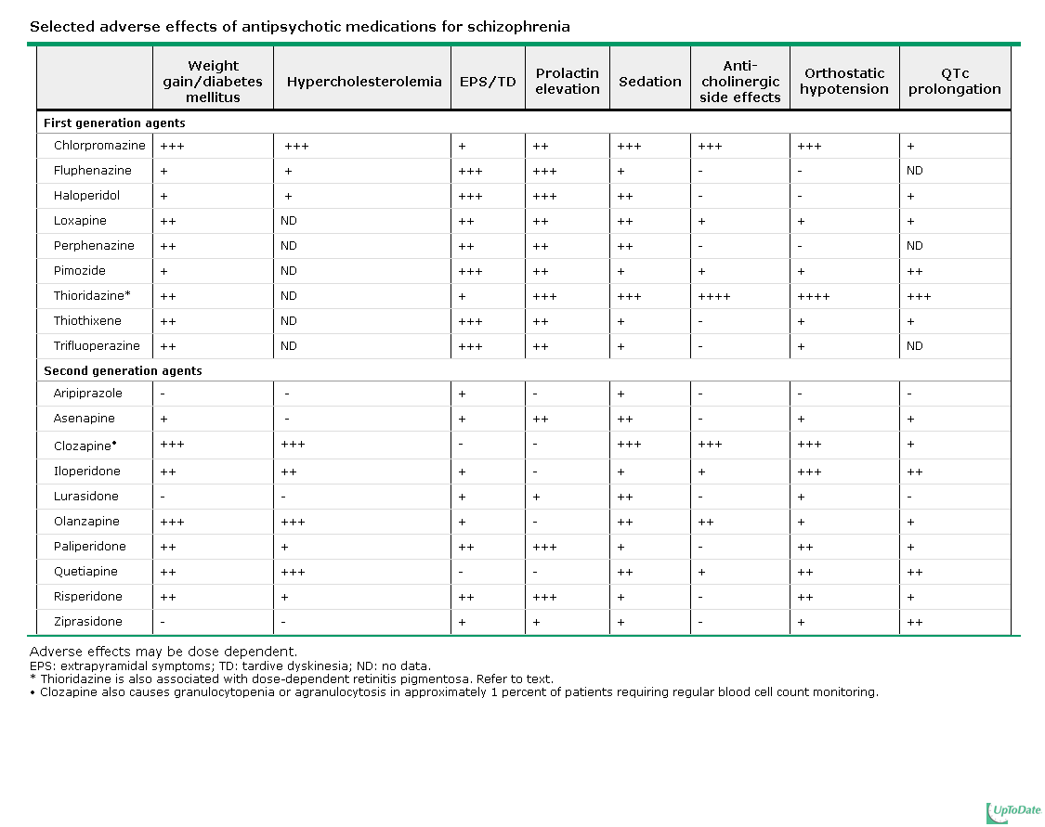

Slide 23
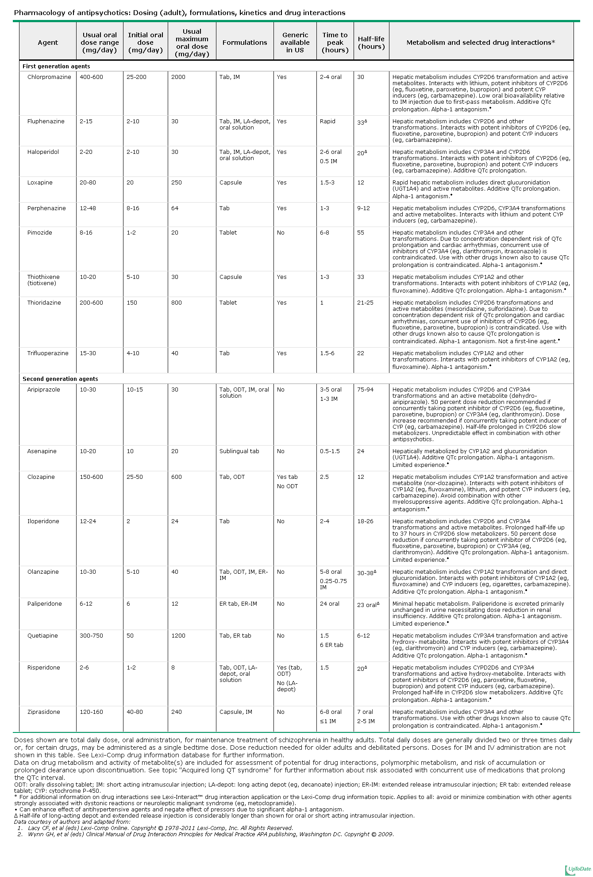

Slide 24
